Slide 1

Responsive Design
Qinfeng Li, Dayu Li

Slide 2
Introduction
Apps need to run on variety of devices from watches to tablet.
Difference device has varied configurations and size of screen for display.
Apps should accommodate different resolution to provide greater user experience.
Jetpack Compose as a modern toolkit for UI development with native support for responsive design.

Slide 3
Jetpack Compose Layouts & Application
App-level composable: The root composable that takes up the entire space allocated to the app. It serves as the main container for all other composables. This composable is responsible for the overall structure and responsiveness of the app’s UI.
The app-level composable manages the overall layout structure and ensures the app adapts across all devices. For instance, it might contain a Scaffold composable to manage a flexible layout structure.

Slide 4
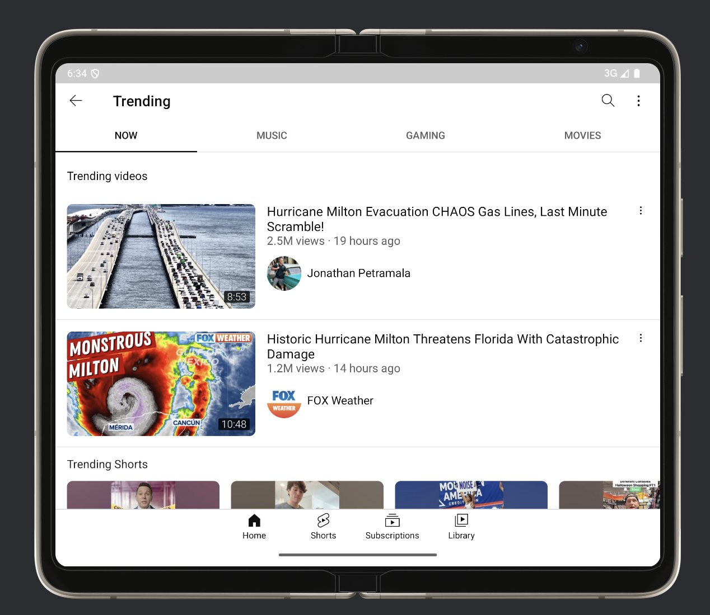
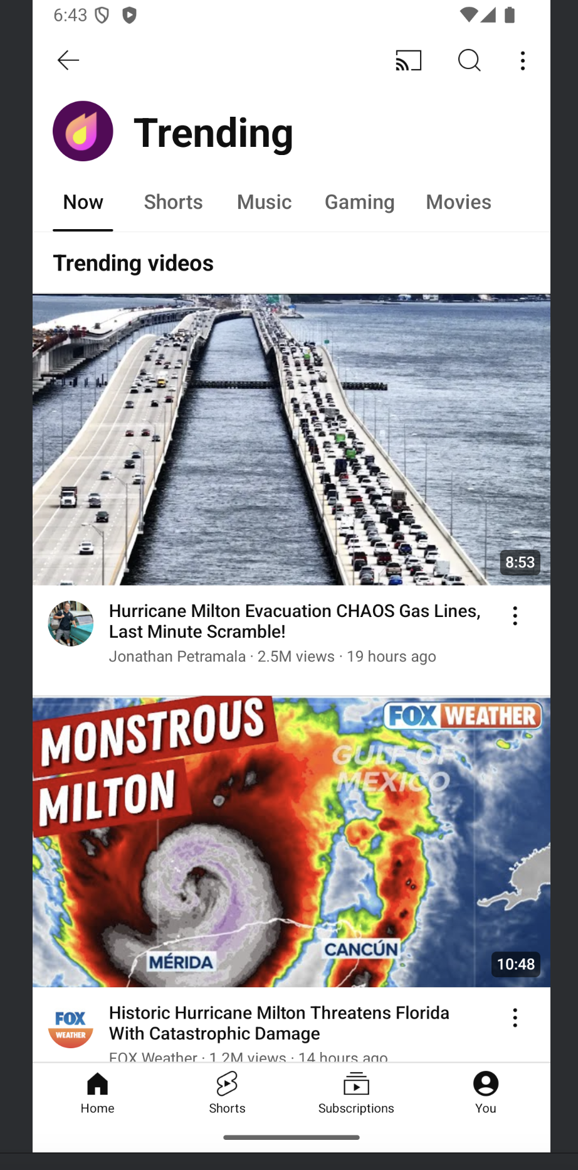
YouTube

Slide 5
Jetpack Compose Layouts & Application
Screen-level composable: A composable that resides within the app-level composable. It occupies the full space available to the app, generally representing specific sections or screens within the app. Each screen-level composable typically corresponds to a destination when navigating through the app.
Screen-level composables adjust their layouts based on the screen size and orientation. On a phone, a screen-level composable may show a single-column layout, while on a tablet, it may switch to a multi-column layout.

Slide 6
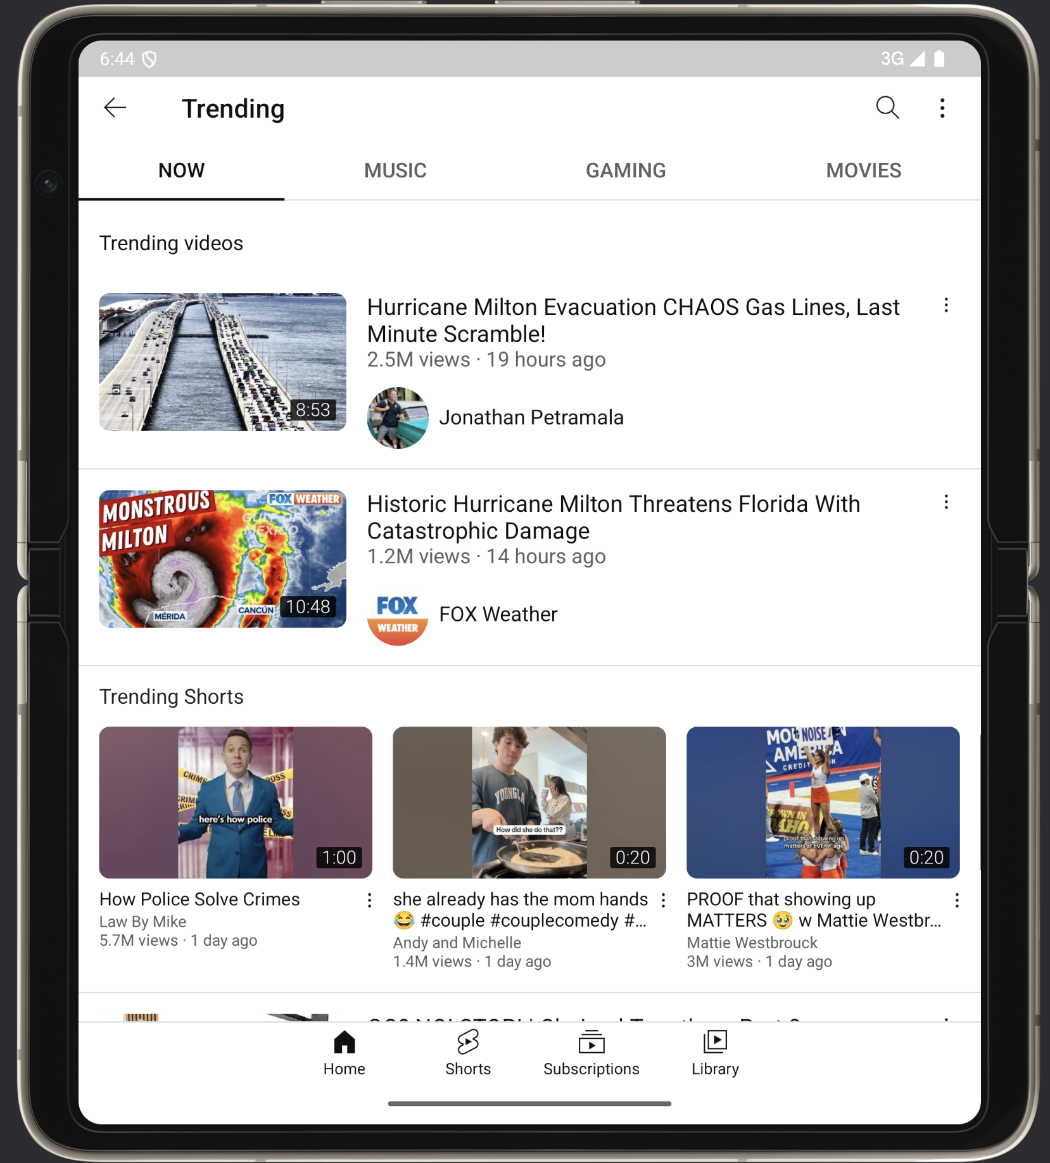

YouTube

Slide 7
Jetpack Compose Layouts & Application
Individual composables: These include all other composables inside the screen-level composables. They can represent smaller UI elements (like buttons or text), reusable content groups, or other composables designed to form the detailed structure of each screen.
Individual composables like Text, Button, and Image components automatically resize and re-arrange themselves to fit the available space, ensuring the UI remains functional and visually appealing on any screen size.

Slide 8
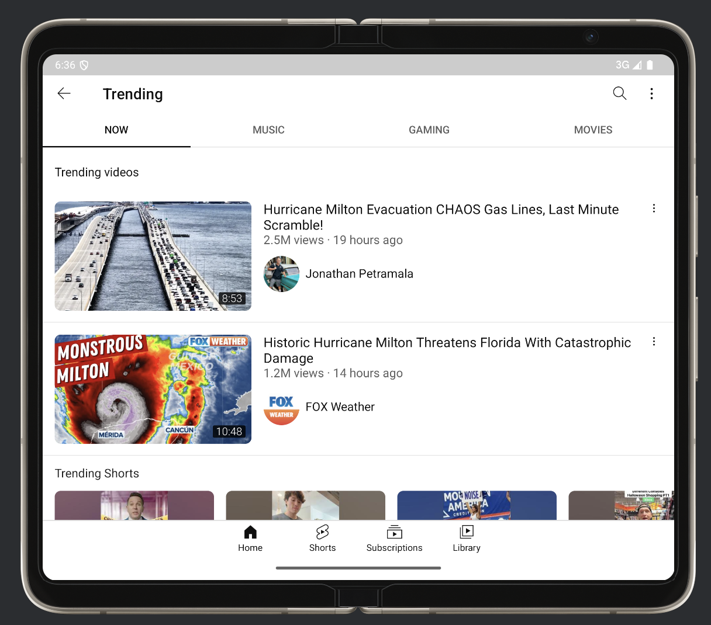
YouTube

Slide 9
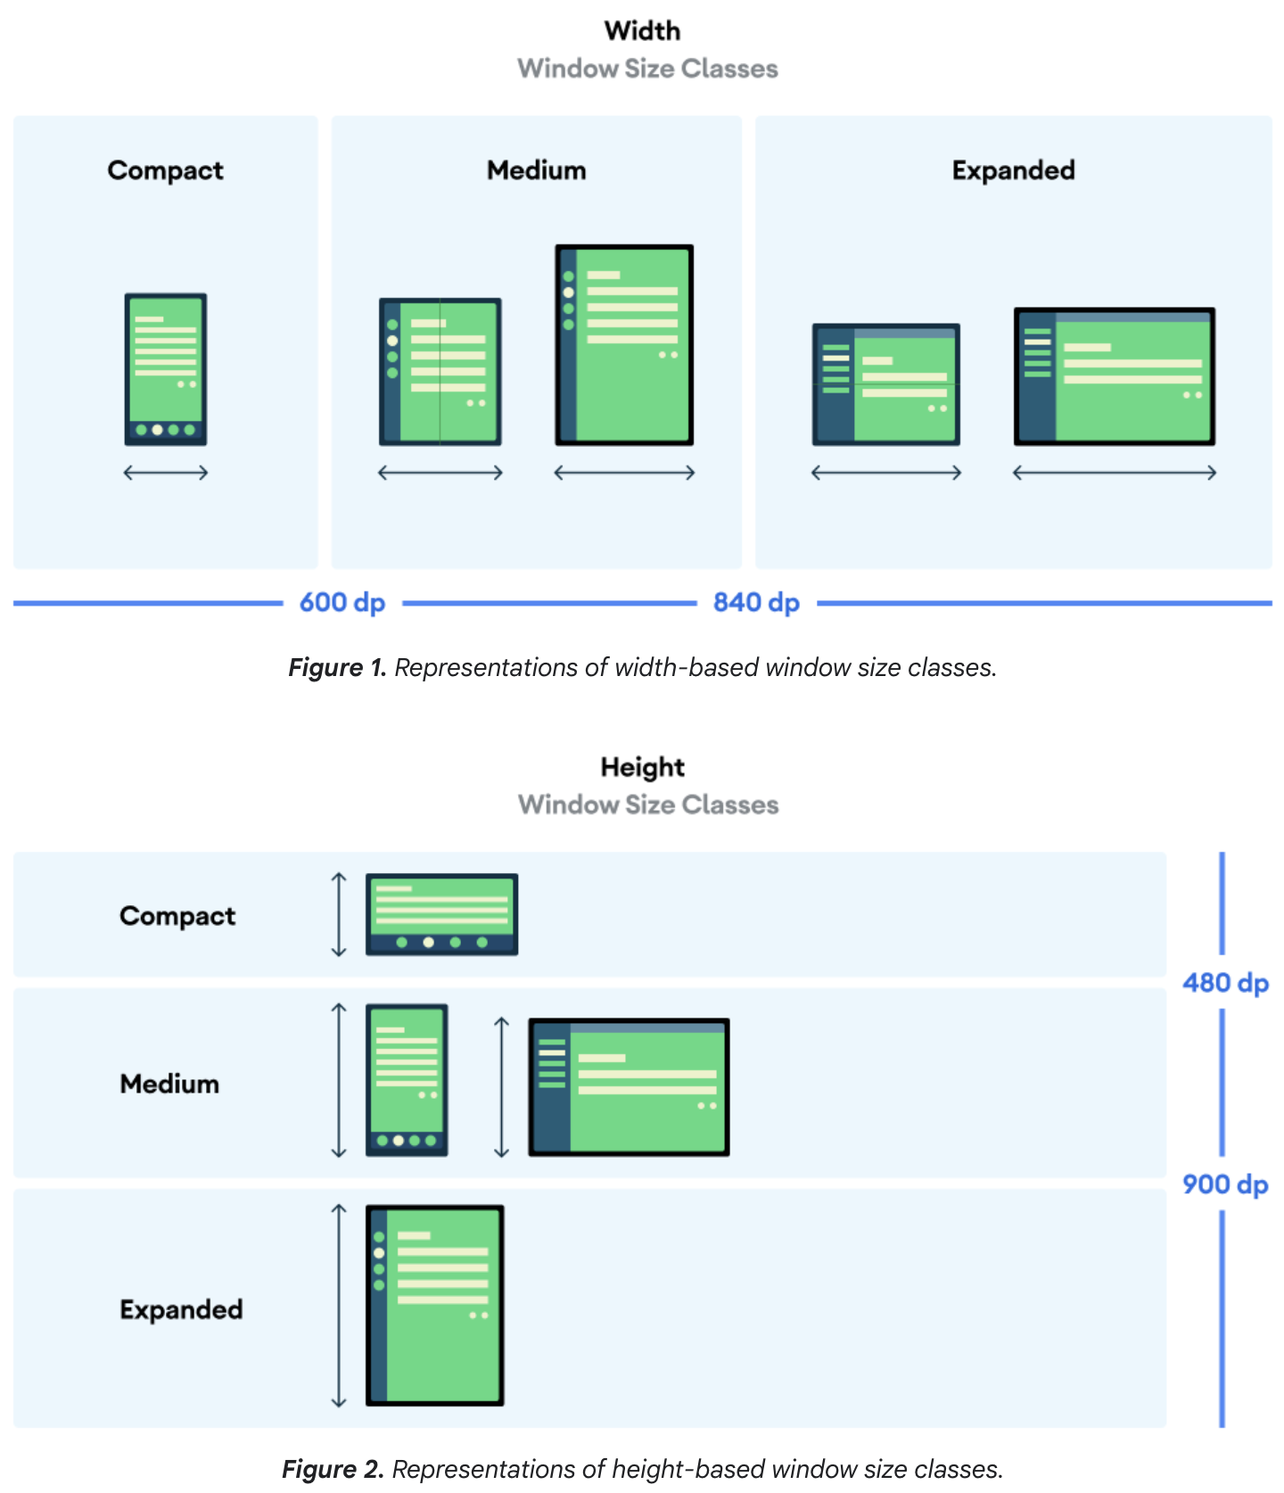
Adapting Layouts with Window Size Classes in Jetpack Compose
What:
Window Size Classes are predefined categories that Jetpack Compose uses to group screens into three main types: Compact, Medium, Expanded.
Why:
Window Size Classes simplify the process of creating adaptive layouts.
Instead of manually checking the screen dimensions, you can rely on these predefined categories to handle layout shifts.
This ensures your app is flexible and looks great on all device types without requiring specific layout adjustments for each screen size.

Slide 10
Demo

Slide 11
Referense
https://developer.android.com/develop/ui/compose/layouts/adaptive/use-window-size-classes
https://developer.android.com/develop/ui/compose/layouts/adaptive/support-different-screen-sizes
https://developer.android.com/develop/ui/compose/layouts/adaptive/support-multi-window-mode

